Slide 1
GPIO (General Purpose I/O)
Raspberry Pi GPIO

Slide 2
Raspberry Pi GPIO
GPIO (General Purpose Input/Output)
General purpose digital I/O interface for embedded system CPU to communicate with peripheral devices
used to get input from or send output signals to external devices
program can use each GPIO port as input or output

Slide 3
Raspberry Pi GPIO
GPIO (General Purpose Input/Output)
GPIO port: 26 ports in Raspberry Pi
some port can be used for serial communications (SPI, I2C, UART, etc.)
power pin: 3.3V, 5V pin
Raspberry Pi operates 3.3V internally; GPIO pin operates 3.3V as well
need to use voltage level converter to use 5V device in GPIO pin

Slide 4
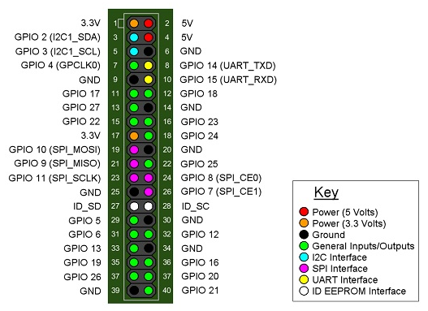
Raspberry Pi Pin Map

Slide 5
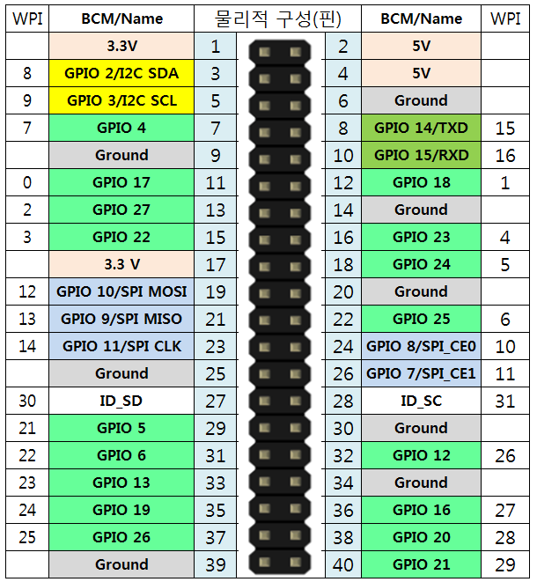
Raspberry Pi Pin Map
python
python
GPIO PINs

Slide 6
GPIO Control Programming
GPIO control
control based on file system access using sysfs
control GPIO port by read/write a special file using sysfs
control using GPIO control software
RPi.GPIO: GPIO control module for Python
WiringPI: GPIO library for C, Python, Ruby

Slide 7
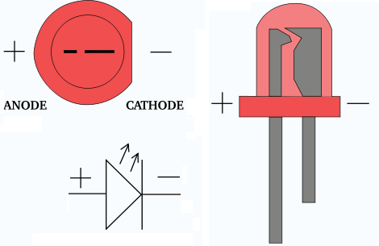
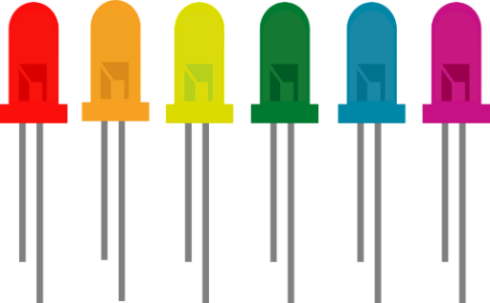
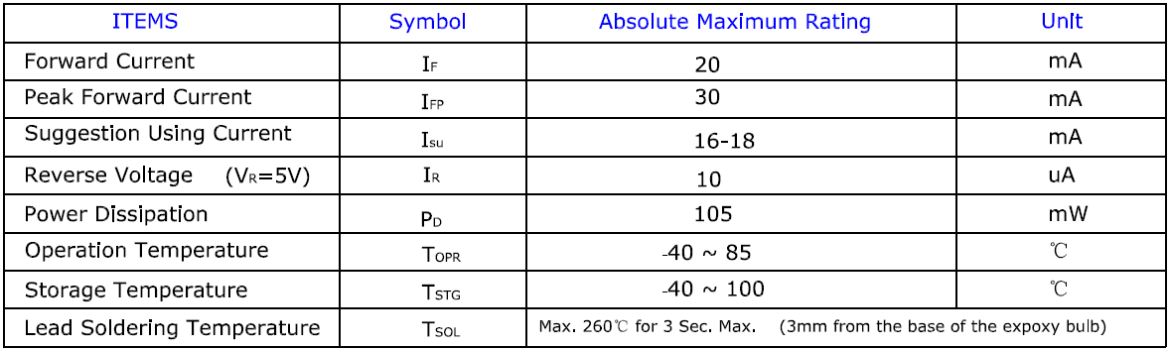
GPIO Control Programming: LED
LED(Light-emitting diode)

Slide 8
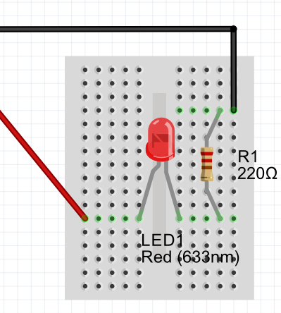
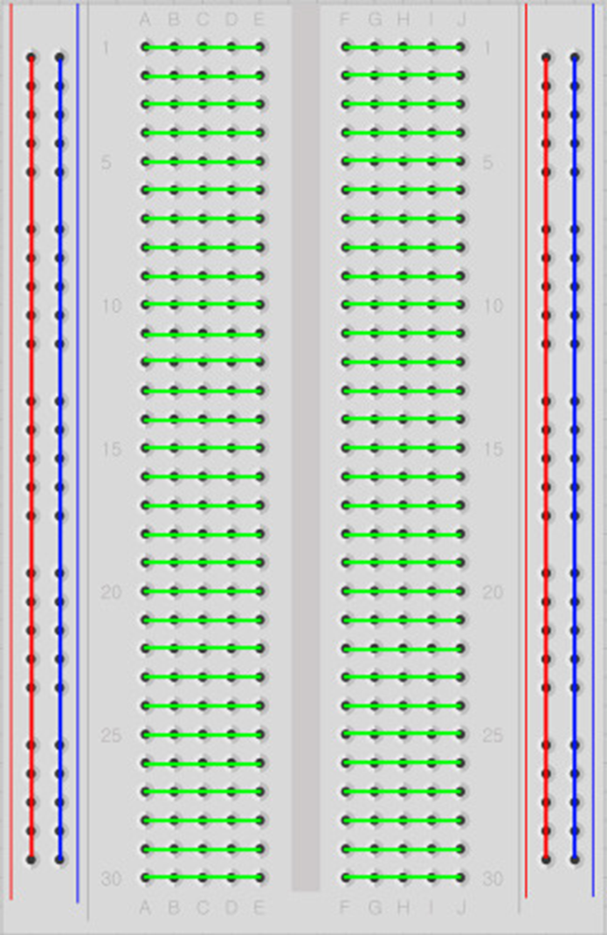
GPIO Control Programming: LED
LED circuit
GND
3.3V
+
-
V = IR → R = V/I = 3.3/0.02 = 165(Ω)
if R = 220, I = V/R = 3.3/220 = 15(mA)
if R = 1KΩ, I = V/R = 3.3/1000 = 3.3(mA)
bread board

Slide 9
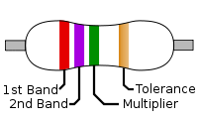
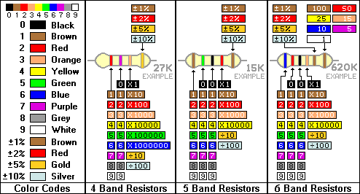
GPIO Control Programming: LED
Resistor

Slide 10
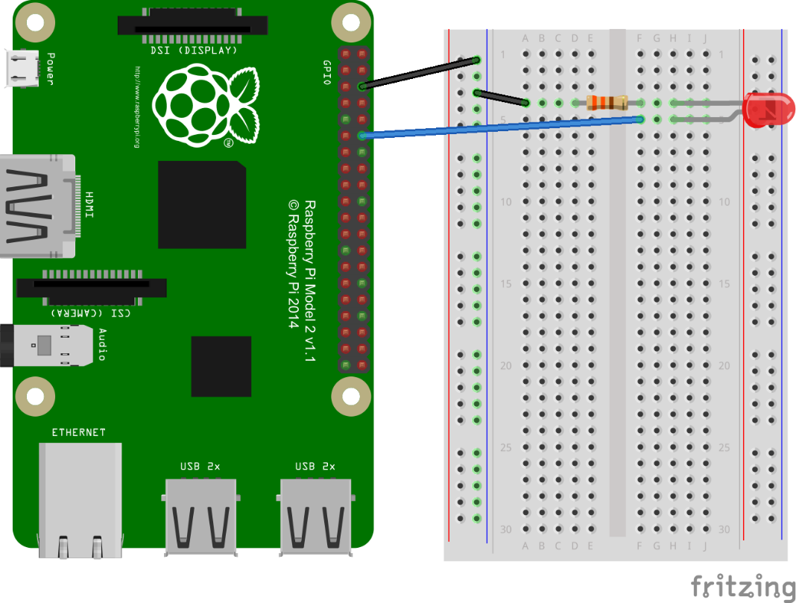
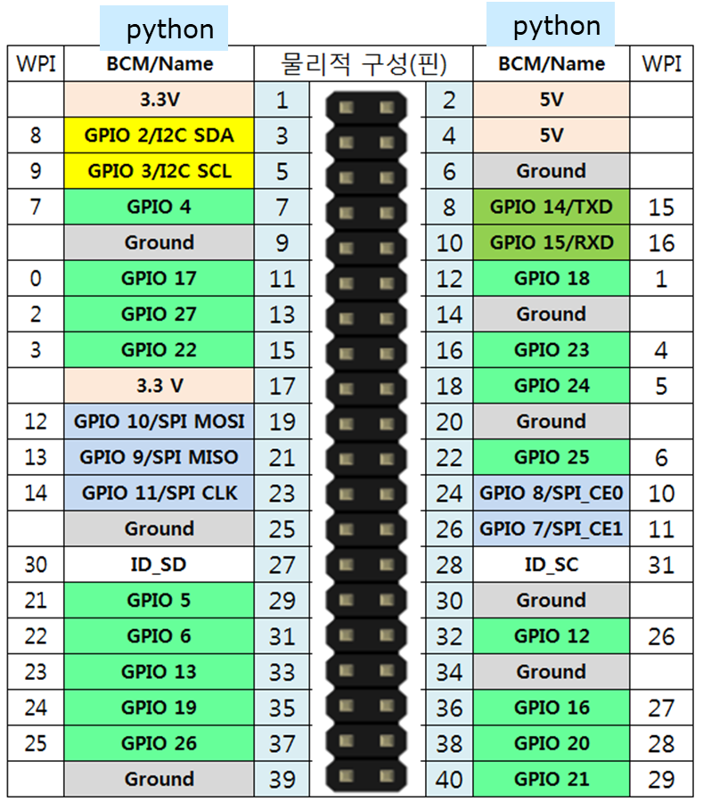
GPIO Control Programming: LED
Pi pin connection
GPIO pin current: 3.3V
led: 20mA
resistor: 165Ω ~ 1KΩ
-
+

Slide 11

GPIO Programming: LED
Python: RPi.GPIO module
Install:
Run :
$ sudo apt-get update
$ sudo apt-get install python-dev
$ sudo apt-get install python-rpi.gpio
$ sudo python3
>>> import RPi.GPIO as GPIO
>>> GPIO.setmode(GPIO.BCM)
>>> GPIO.setup(18, GPIO.OUT)
>>> GPIO.output(18, True)
>>> GPIO.output(18, False)
set pin numbering mode

Slide 12
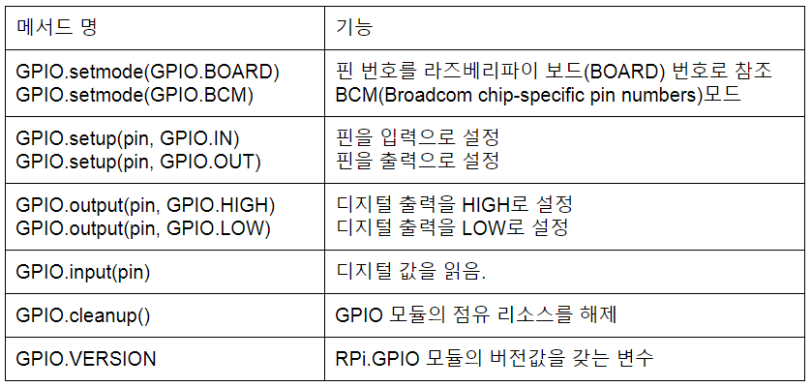
GPIO Programming: LED
Python: RPi.GPIO module
methods

Slide 13
GPIO Programming: LED
Python: Rpi.GPIO module
Run : blink.py
import RPi.GPIO as GPIO
import time
GPIO.setmode(GPIO.BCM)
GPIO.setup(18, GPIO.OUT)
while (True):
GPIO.output(18, True)
time.sleep(1)
GPIO.output(18, False)
time.sleep(1)
$ sudo python3 blink.py

Slide 14
GPIO Programming: LED
프로그래밍 실습
2 leds (red, blue) : gpio 23, 24
loop: sleep 1 sec for each step
red, blue: off, off
red, blue: off, on
red, blue: on, off
red, blue: on, on
위 과정을 계속 반복

Slide 15
거리측정센서
Distance sensor
HC-SR04 Ultrasonic sensor
PIR sensor

Slide 16
Measuring Distance
Ultrasonic sensor (초음파센서)
Use ultra-sonic echoes : humans can’t hear it
Provide exact distance readings
Infrared (IR) sensor (적외선센서)
Passive infrared (PIR) sensors:
detect the presence of hot things in the measured area by detecting the heat they radiate

Slide 17
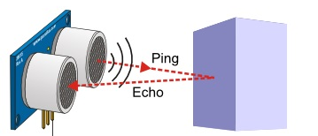
Ultrasonic Sensor
Measuring distance
uses ultra-sonic echoes
propagation speed: 340m/s

Slide 18
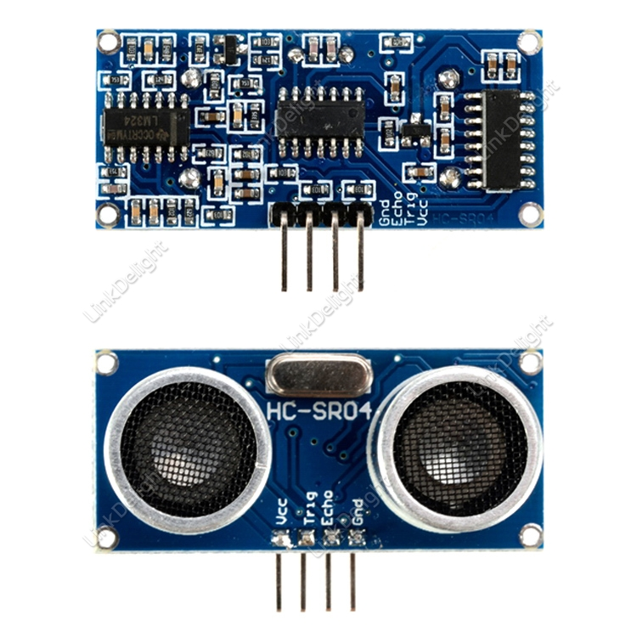
Ultrasonic Sensor
HC-SR04 Ultrasonic sensor
Measurable Range: 2 ~ 400 cm
Basic principle of work:
Using IO trigger for at least 10us high level signal
Module automatically sends eight 40kHz pulses and detect whether there is a pulse signal back
If the signal back, through high level, time of high output IO duration is the time from sending ultrasonic to returning

Slide 19
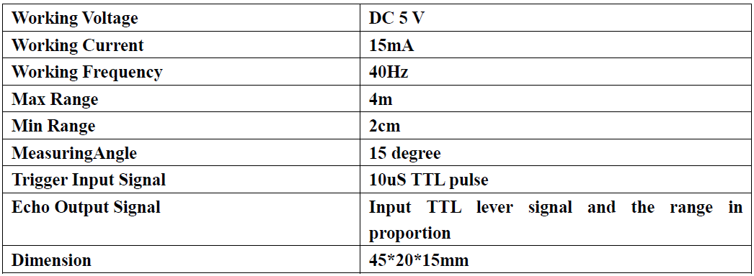
Ultrasonic Sensor
HC-SR04 Ultrasonic sensor
distance = [(high level time) x velocity of sound (340m/s)] / 2
distance(cm) = duration(s) * 34000 / 2.
distance(cm) = [end(μs) – start(μs)] / 29. / 2. ; 29cm/μs
Electronic Parameters:

Slide 20
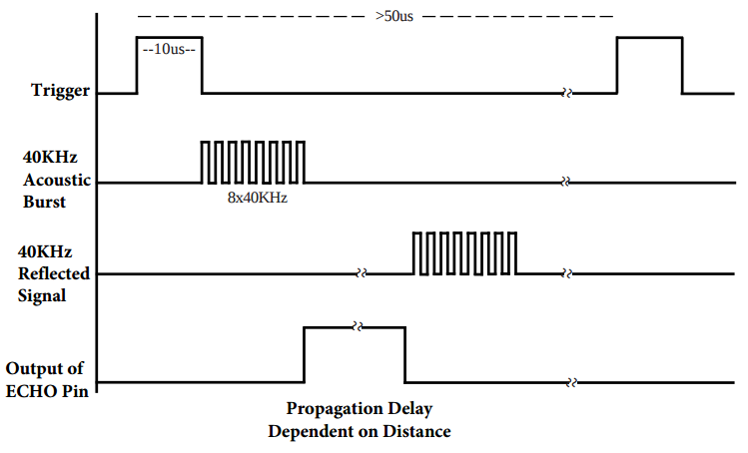
Ultrasonic Sensor
HC-SR04 Ultrasonic sensor
Timing diagram
5V
5V

Slide 21
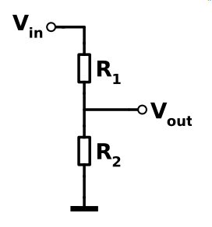
Ranging Project – Source Code
HC-SR04 Ultrasonic sensor
Trigger, Echo pulse voltage: +5V
Raspberry Pi: +3.3V
needs Voltage divider
V_{in}= +5V
센서 echo pin
= 2KΩ
RP gpio 핀
= 3KΩ
V_{out} = V_{in} * ( )) = 3
R2
R1 + R2

Slide 22
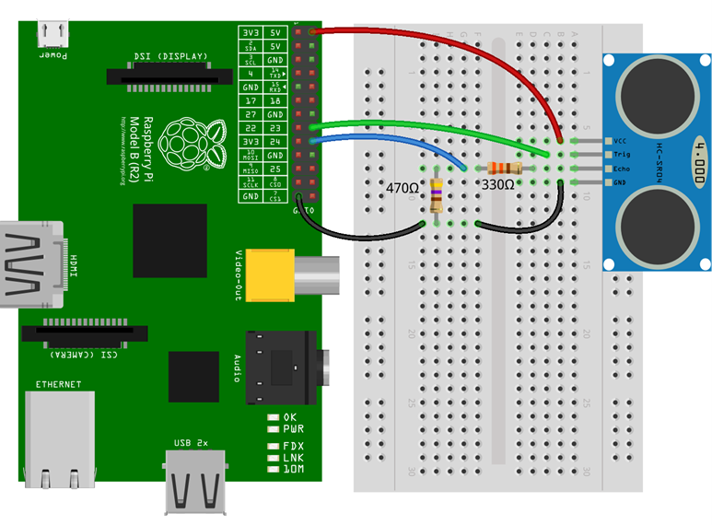
Ranging Project – Source Code
HC-SR04 Ultrasonic sensor: Schematic
Trig: gpio23
Echo: gpio24
python
python

Slide 23
Ranging Program – RPi.GPIO
Program: distance.py
import time
import RPi.GPIO as GPIO
GPIO.setmode(GPIO.BCM)
GPIO_TRIGGER = 23
GPIO_ECHO = 24
print ("Distance measurement starts … \n“)
GPIO.setup(GPIO_TRIGGER, GPIO.OUT)
GPIO.setup(GPIO_ECHO, GPIO.IN)
try:
while True:
start, stop = 0, 0
GPIO.output(GPIO_TRIGGER, False)
time.sleep(2)
GPIO.output(GPIO_TRIGGER, True)
time.sleep(0.00001)
GPIO.output(GPIO_TRIGGER, False)

Slide 24
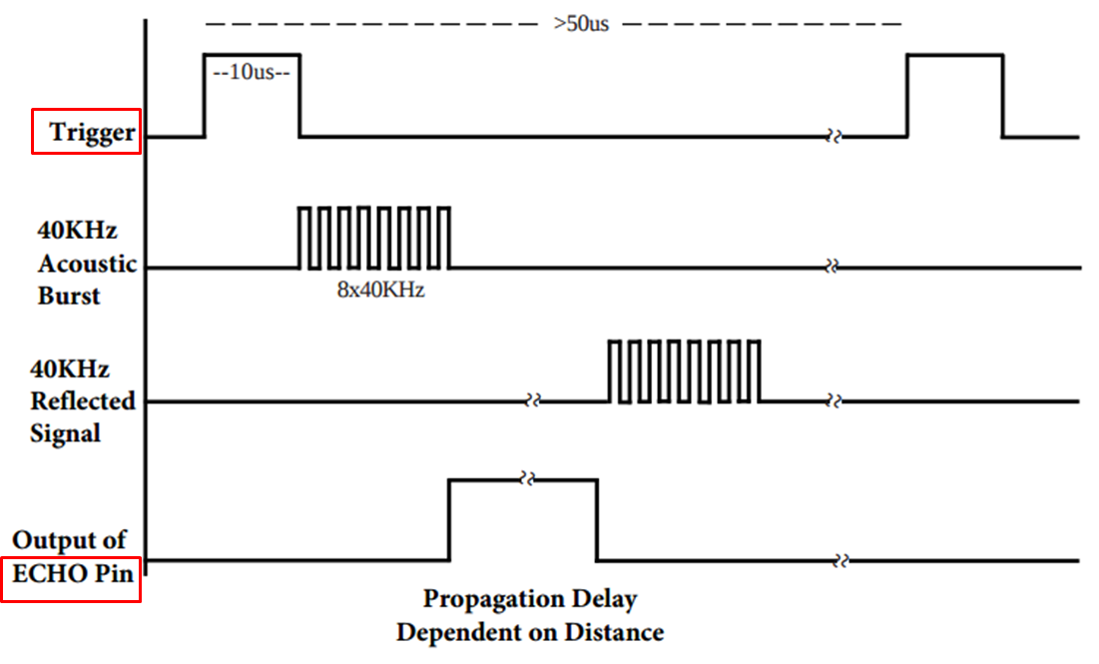
Ranging Program – RPi.GPIO
Program: distance.py
while GPIO.input(GPIO_ECHO)==0:
start = time.time()
while GPIO.input(GPIO_ECHO)==1:
stop = time.time()
elapsed = stop-start
distance = (elapsed * 34000.0) / 2.
print ("Distance : %.1f cm\n" % distance)
except KeyboardInterrupt:
print ("Distance measurement ends\n“)
GPIO.cleanup()
GPIO.cleanup()

Slide 25
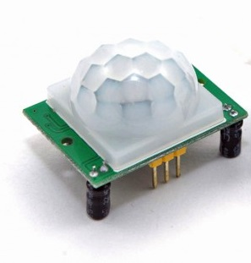
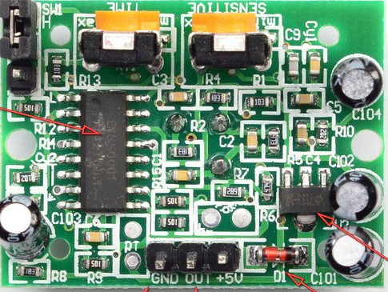
PIR Motion Sensor Module
Passive Infrared Sensor: HC-SR501
GND
Vcc (5~20V)
OUT

Slide 26
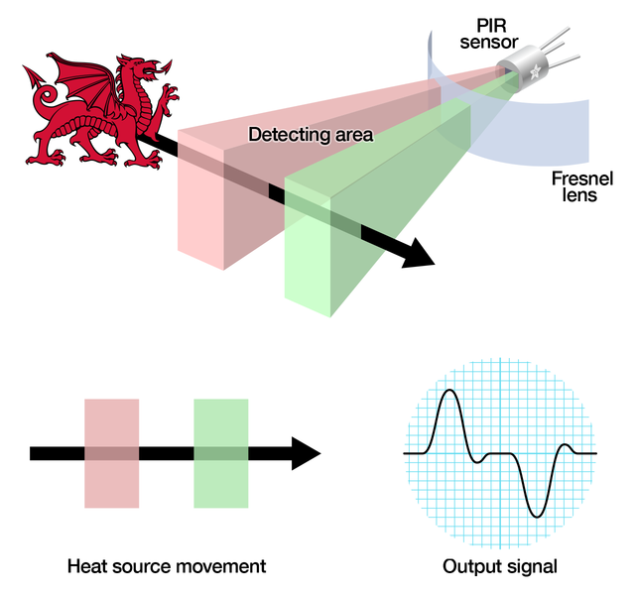
PIR Motion Sensor Module
Passive Infrared Sensor: HC-SR501
Operation

Slide 27
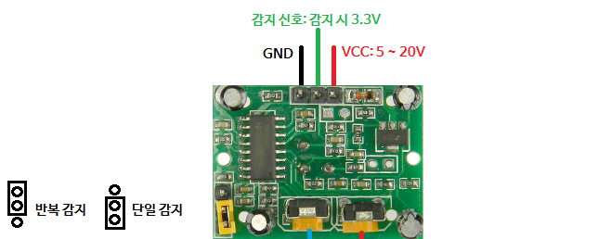
PIR Motion Sensor Module
Passive Infrared Sensor: HC-SR501
Single triggering vs. multiple triggering
Single triggering: if detected, output for a fixed time and disable the detection during a specified time (~3s)
Retriggering: every time detected, output for a fixed time

Slide 28
PIR Motion Sensor Module
HC-SR501 Specification
Voltage: 5V ~ 20V
Power Consumption: 65mA
TTL output: 3.3V, 0V
Trigger mode: L-disable repeat trigger, H-enable repeat trigger (default)
Sensing range: less than 120 degree, within 7 meters

Slide 29
Ranging Program – RPi.GPIO
Program: pir_rpi.py
import RPi.GPIO as GPIO
import time
GPIO.setmode(GPIO.BCM)
pirPin = 18
GPIO.setup(pirPin, GPIO.IN)
try:
while True:
if GPIO.input(pirPin) == GPIO.HIGH:
print ("Motion detected!\n“)
else:
print ("No motion\n“)
time.sleep(1)
except KeyboardInterrupt: # ctrl-C
print (“Motion detection ends\n“)
GPIO.cleanup()
GPIO.cleanup()

Slide 30
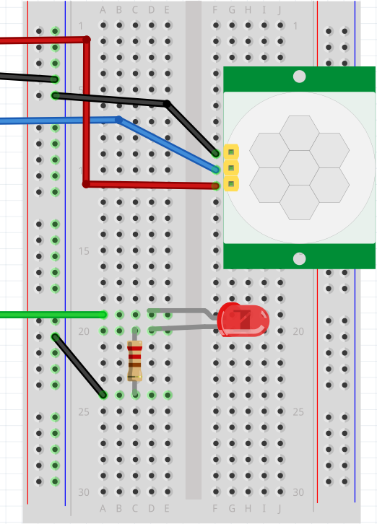
Ranging Program – RPi.GPIO
HC-SR501: Schematic
PIR out: gpio 23
LED: gpio 25
5V
GND
gpio 23
gpio 25

Slide 31
Ranging Program – RPi.GPIO
Program: pir_rpi2.py
import RPi.GPIO as GPIO
import time
GPIOIN = 23 # PIR pin
GPIOOUT = 25 # LED pin
GPIO.setmode(GPIO.BCM)
print ("HC-SR501 motion detection start \n“)
GPIO.setup(GPIOIN, GPIO.IN)
GPIO.setup(GPIOOUT, GPIO.OUT)
try:
while True:
state = GPIO.input(GPIOIN)
if(state == True):
print ("state: Motion detected\n“)
else:
print ("state: No Motion\n“)
GPIO.output(GPIOOUT, state)
time.sleep(1)
except KeyboardInterrupt:
print (“Motion detection ends\n“)
GPIO.cleanup()
print ("HC-SR501 motion detection end“)

Slide 32
프로그래밍 실습
거리측정센서 Programming
ultra-sonic sensor: trig 핀을 gpio23, echo 핀을 gpio24 번에 연결
led: gpio18 번 핀에 연결
초기상태: OFF
2초 간격으로 while 반복문 수행:
초음파센서를 통해 거리 측정
거리 < 10cm : LED 를 ON
아니면 : LED 를 OFF
파이썬 프로그램 작성: distance.py

